Slide 1
Next level Docker
Training

Slide 2
Agenda
https://docs.google.com/document/d/1p0xZ5nDi8_Yz-OgY8gut9rOgdfZcA5M8/edit?usp=sharing&ouid=108972485768906927376&rtpof=true&sd=true

Slide 3
Training Format
Concepts
Hands-on exercises
Assignments
Interactive

Slide 4
Timing
Start time at 9 am
Break 11 am
Lunch 1pm to 2pm
Break 3.30 pm
End at 5 pm

Slide 5
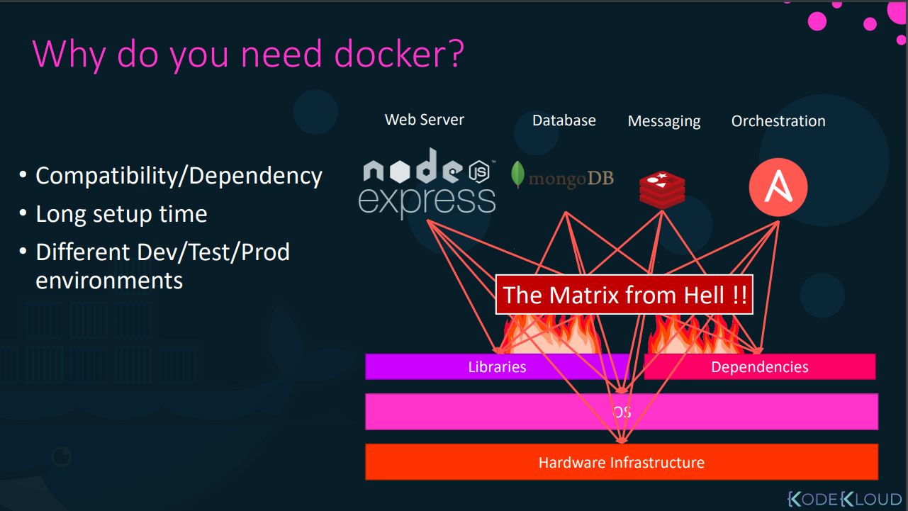

Slide 6
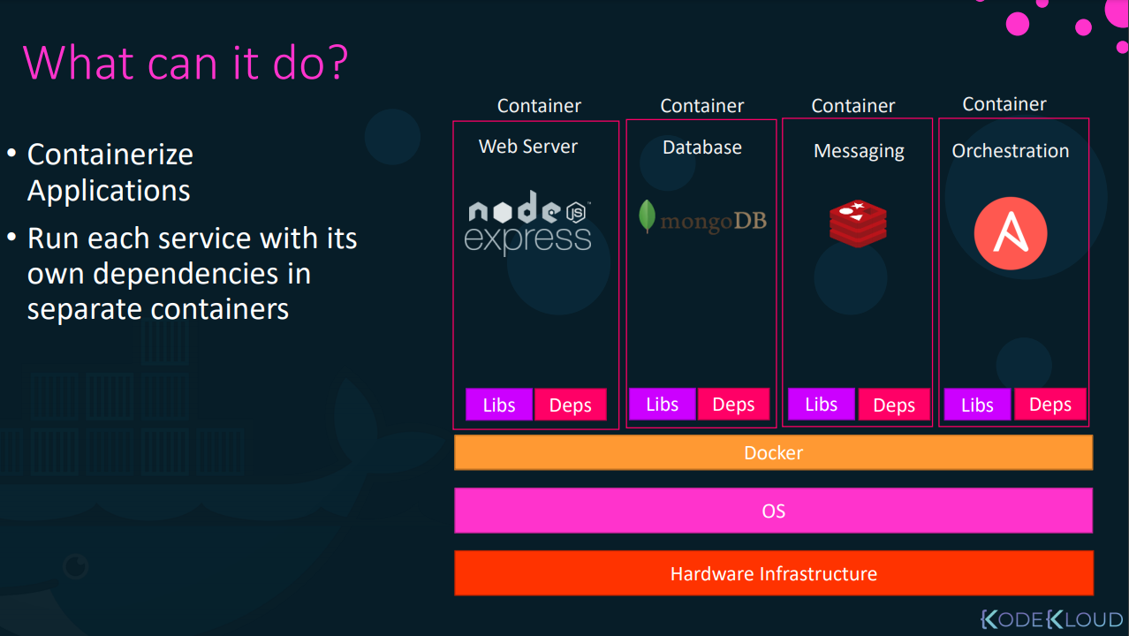

Slide 7
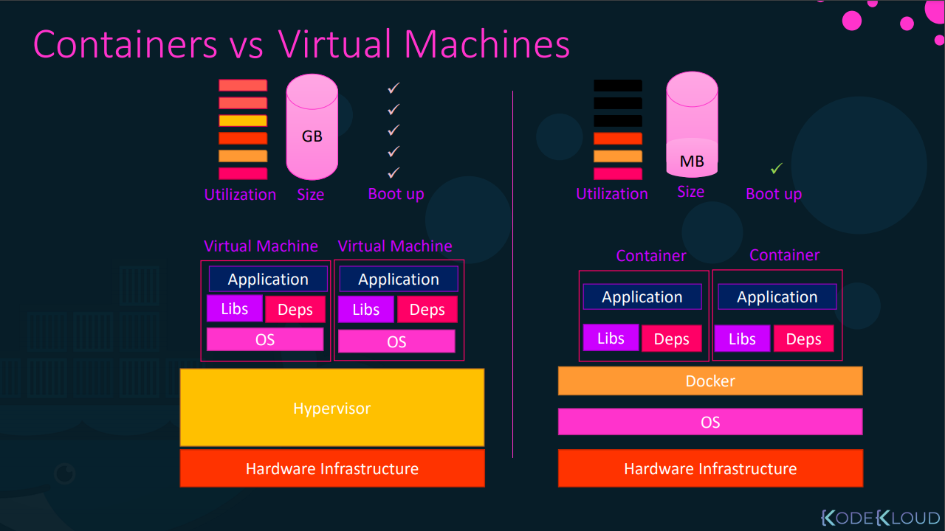

Slide 8
Docker
Docker is an open platform for developing, shipping, and running applications.
Docker enables you to separate your applications from your infrastructure so you can deliver software quickly.
With Docker, you can manage your infrastructure in the same ways you manage your applications.
By taking advantage of Docker’s methodologies for shipping, testing, and deploying code quickly, you can significantly reduce the delay between writing code and running it in production.

Slide 9
Docker
Docker provides the ability to package and run an application in a loosely isolated environment called a container.
The isolation and security allows you to run many containers simultaneously on a given host.
Containers are lightweight and contain everything needed to run the application, so you do not need to rely on what is currently installed on the host.
You can easily share containers while you work, and be sure that everyone you share with gets the same container that works in the same way.

Slide 10
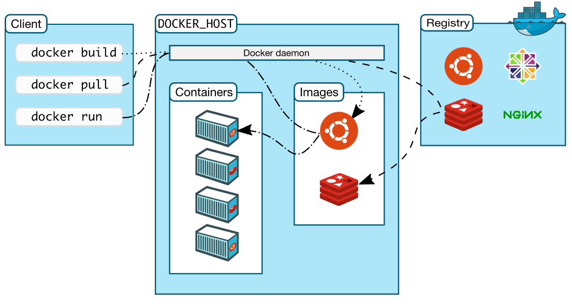
Docker architecture

Slide 11
Docker commands
docker container run --publish 80:80 nginx
docker container run --publish 80:80 --detach nginx
docker container ls
docker container stop
docker container ls
docker container ls -a
docker container run --publish 80:80 --detach --name webhost nginx
docker container run -d -p 3306:3306 --name db -e MYSQL_RANDOM_ROOT_PASSWORD=yes mysql

Slide 12
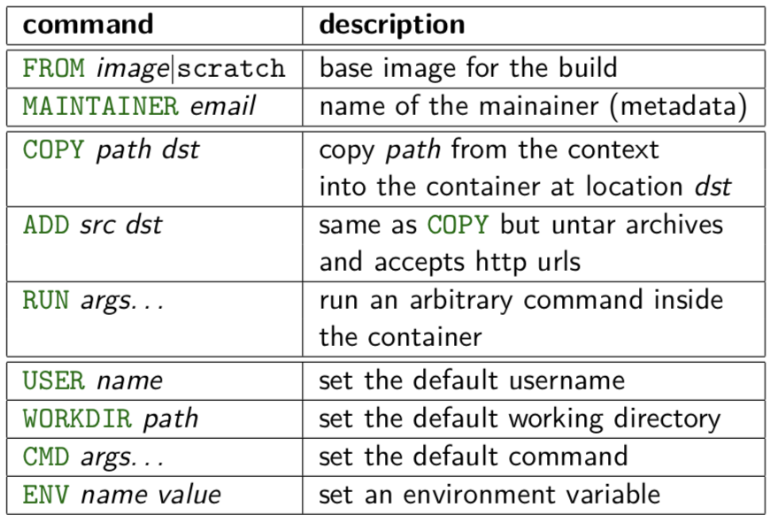
Dockerfile
https://docs.docker.com/engine/reference/builder/

Slide 13
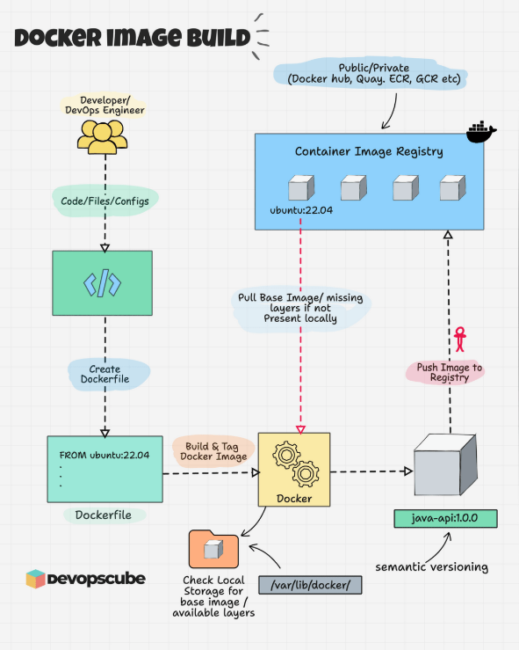

Slide 14
Volumes
By default all files created inside a container are stored on a writable container layer. This means that:
The data doesn’t persist when that container no longer exists, and it can be difficult to get the data out of the container if another process needs it.
A container’s writable layer is tightly coupled to the host machine where the container is running. You can’t easily move the data somewhere else.
Writing into a container’s writable layer requires a storage driver to manage the filesystem. The storage driver provides a union filesystem, using the Linux kernel. This extra abstraction reduces performance as compared to using data volumes, which write directly to the host filesystem.

Slide 15
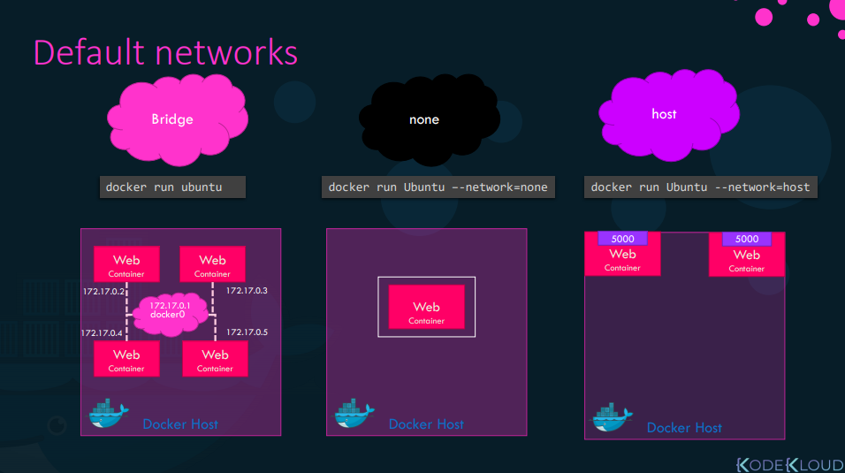
https://docs.docker.com/network/

Slide 16
Why Advanced Docker Image Building Matters
Docker images are production-grade artifacts, not simple packages
Inefficient images increase build time, cost, and security risk
Modern platforms require both AMD64 and ARM64 support
CI/CD pipelines rely heavily on optimized container builds
ML and GenAI workloads amplify dependency and image-size challenges
Advanced techniques improve reliability, speed, and portability

Slide 17
Writing Clean & Efficient Dockerfiles
Select minimal and trusted base images (slim or distroless)
Avoid 'latest' tags and pin exact image versions
Order instructions to maximize build cache reuse
Combine related RUN instructions to reduce layers
Use .dockerignore to minimize build context
Clearly separate build-time and runtime responsibilities

Slide 18
Why Image Size Matters
Smaller images reduce CI/CD build and pull times
Lower storage and network transfer costs
Reduced attack surface and vulnerability exposure
Faster cold starts for AI and serverless workloads
Improved developer feedback and iteration speed
Direct impact on security, cost, and performance

Slide 19
Dockerfile Patterns for ML & GenAI Workloads
Separate model download and application runtime stages
Cache model layers independently to avoid rebuilds
Handle large dependencies like PyTorch carefully
Explicitly design CPU vs GPU images
Balance image size against inference cold-start time
Prepare images for restricted or offline environments

Slide 20
Dockerfile Anti-Patterns to Avoid
Using 'latest' tags causing non-deterministic builds
Installing build tools in production images
Copying entire repositories unnecessarily
Running containers as root users
Embedding secrets via ENV or ARG
Ignoring .dockerignore files

Slide 21
Multi-Stage Docker Builds
Use multiple FROM statements to isolate build stages
Builder stages include compilers and development tools
Final runtime stage contains only required binaries
Reduces image size and attack surface
Improves runtime security and performance
Ideal for Node.js, Python, Go, and ML workloads

Slide 22
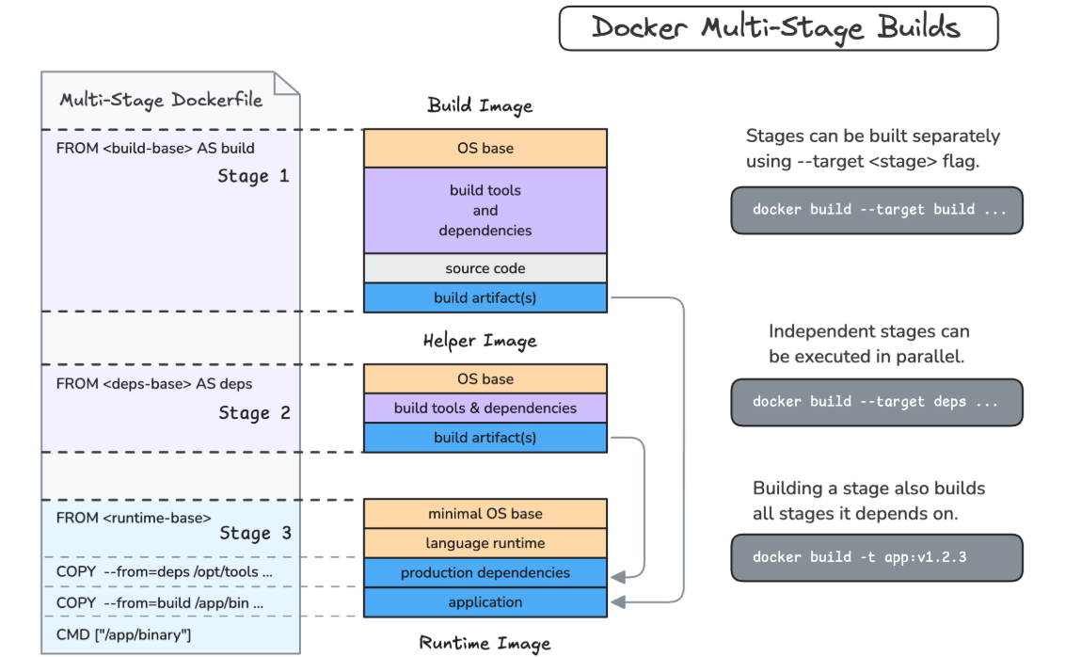

Slide 23
Build Caching with Docker BuildKit
BuildKit is the modern engine for Docker builds
Enables efficient layer reuse across builds
Supports cache mounts for package managers
Reduces rebuild time in CI/CD environments
Allows secure handling of secrets during builds
Required for scalable, modern pipelines

Slide 24
BuildKit Features Used in Real Pipelines
Parallel execution of independent build steps
Cache mounts for pip, npm, apt, and model artifacts
Secure secret mounts for credentials and tokens
Inline metadata and build provenance generation
Improved build error visibility and diagnostics
Essential backend for CI/CD automation

Slide 25
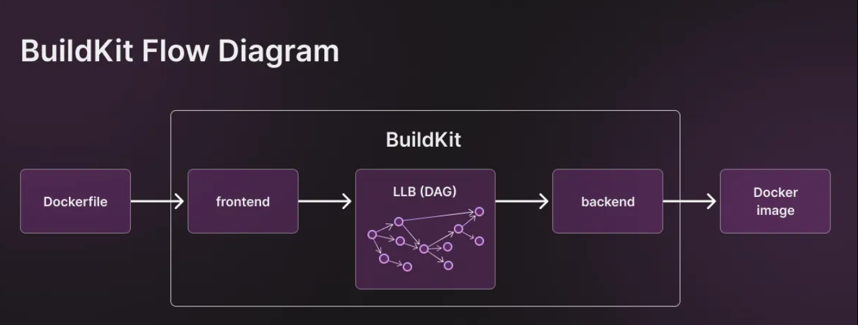

Slide 26
Docker Buildx & Multi-Architecture Builds
Buildx extends Docker with multi-platform build support
Build images for linux/amd64 and linux/arm64
Critical for Apple Silicon and ARM-based clouds
Uses QEMU emulation for cross-platform builds
Produces multi-arch manifest lists under one tag
Integrates with Docker Hub and private registries

Slide 27
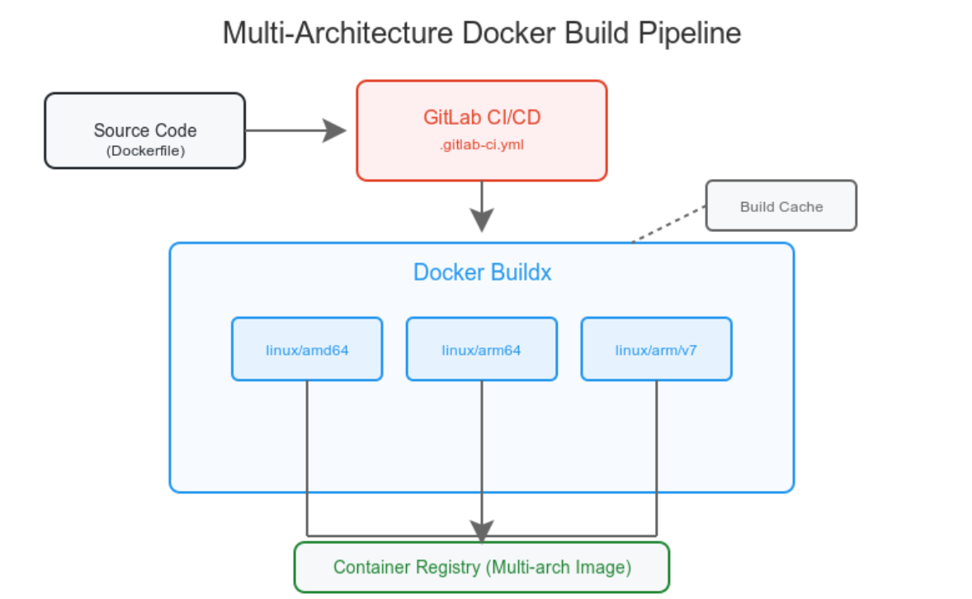

Slide 28
Multi-Architecture Strategy: When and When Not
Mandatory for heterogeneous developer environments
Required for ARM-based cloud platforms
Optional for internal, single-architecture services
QEMU emulation increases build duration
CI resource and time trade-offs must be considered
Recommended strategy: build once, run everywhere

Slide 29
Key Takeaways from Module 1
Dockerfiles must be treated as production code
Multi-stage builds are essential for secure images
Build caching dramatically improves CI/CD speed
Multi-architecture images are now standard practice
BuildKit and Buildx are mandatory modern skills
These foundations enable secure GenAI workloads

Slide 30
Why Image Security Matters
Container images are part of the software supply chain
Vulnerabilities often originate from base images and dependencies
Insecure images increase risk of runtime compromise
Compliance standards increasingly mandate SBOMs
Security must be shifted left into the build process
Image security directly impacts production stability

Slide 31
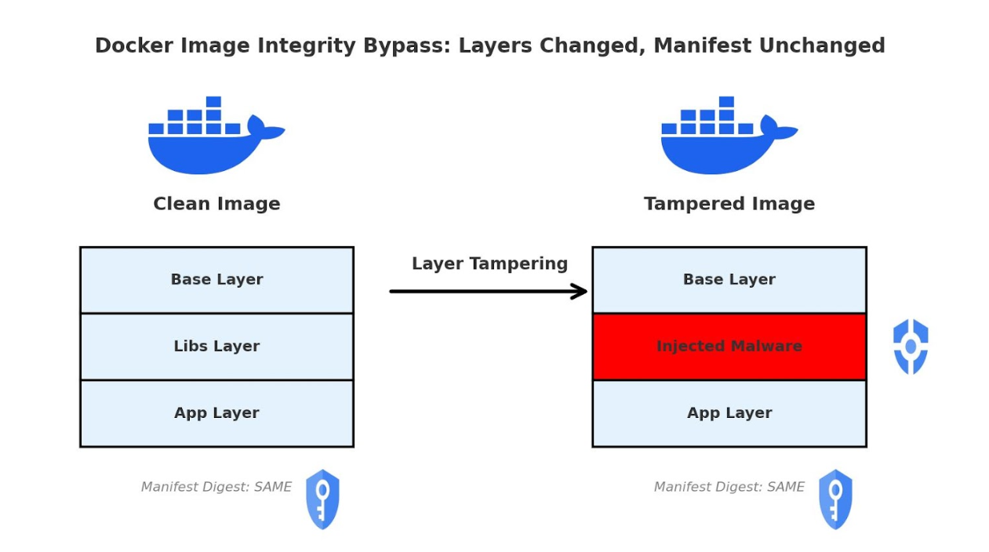
Why Image Security Matters

Slide 32
Understanding Software Supply Chain Security
Images include OS packages, language libraries, and application code
Each dependency introduces potential vulnerabilities
Attackers exploit outdated or unpatched dependencies
SBOMs provide transparency into image contents
Security scanning identifies known CVEs early
Supply chain security is critical for enterprise environments

Slide 33
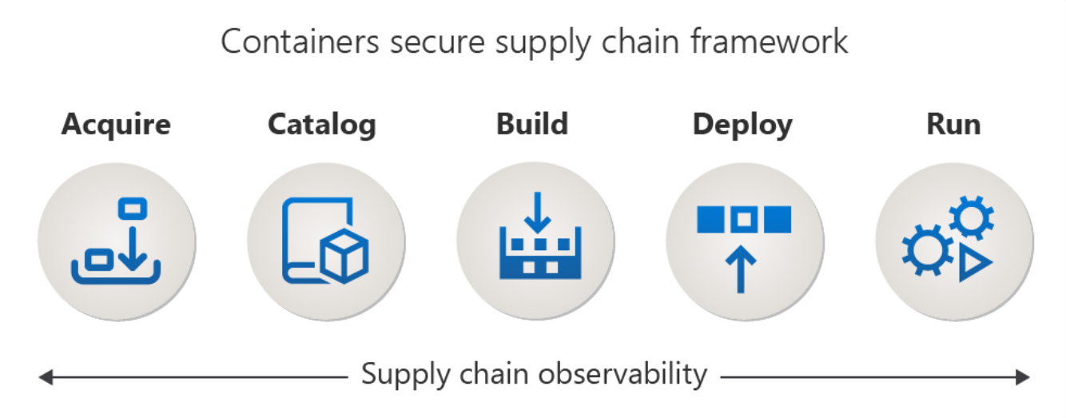
Understanding Software Supply Chain Security

Slide 34
Software Bill of Materials (SBOM)
SBOM is a complete inventory of software components
Common formats include SPDX and CycloneDX
SBOMs enable auditing, compliance, and vulnerability tracking
Required by many security frameworks and regulations
SBOMs improve visibility into transitive dependencies
Foundation for automated security policies

Slide 35
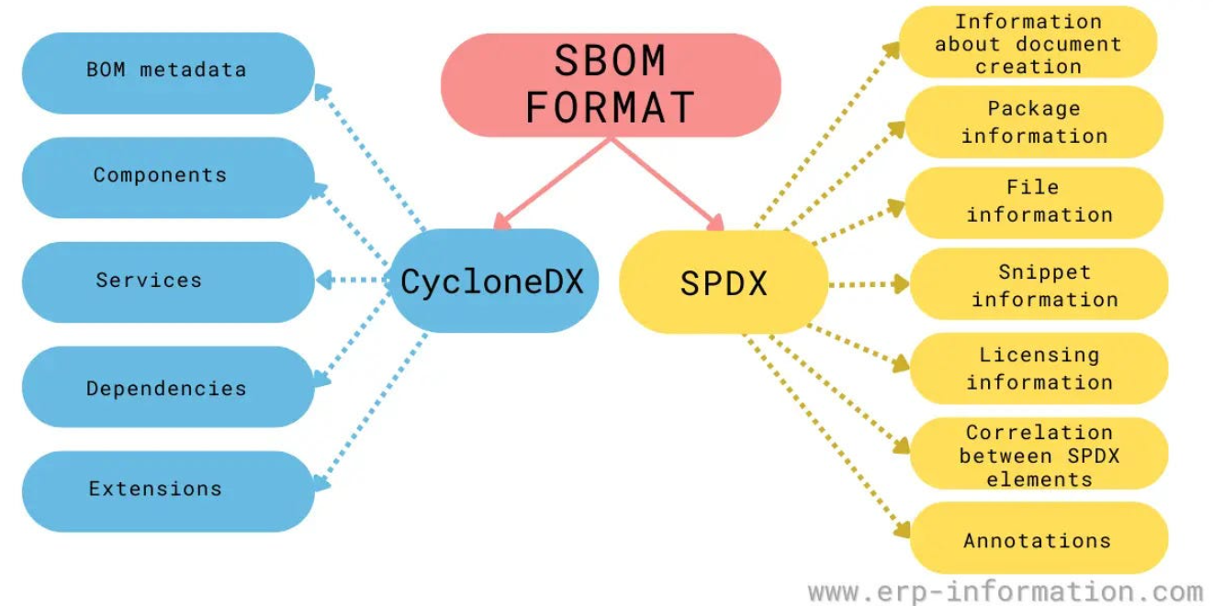
Software Bill of Materials (SBOM)

Slide 36
Generating SBOMs with Docker Tools
docker sbom generates SBOMs directly from images
Supports industry-standard SBOM formats
SBOM generation can be automated in CI pipelines
Outputs are machine-readable and auditable
SBOMs can be stored as build artifacts
Critical input for security and compliance teams

Slide 37
Vulnerability Scanning Overview
Vulnerability scanners detect known CVEs in images
Scans include OS packages and application dependencies
Severity levels help prioritize remediation
False positives must be evaluated carefully
Scanning should occur during build, not after deployment
Automated scanning improves security posture

Slide 38
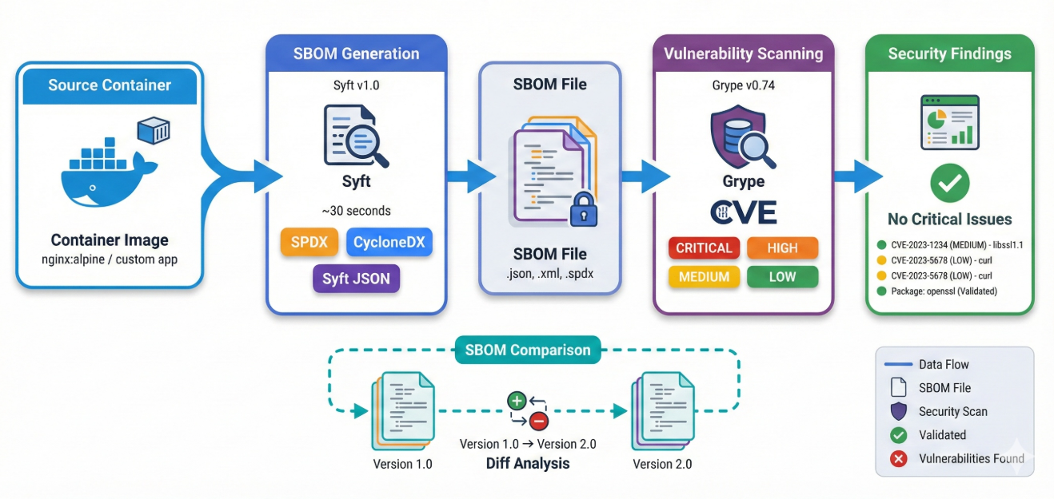
Vulnerability Scanning Overview

Slide 39
Docker Scout for Image Security
Docker Scout analyzes image contents and vulnerabilities
Provides CVE severity and fix recommendations
Integrates directly with Docker CLI and registries
Tracks base image updates and remediation paths
Supports policy enforcement in CI/CD
Ideal for continuous image security monitoring

Slide 40
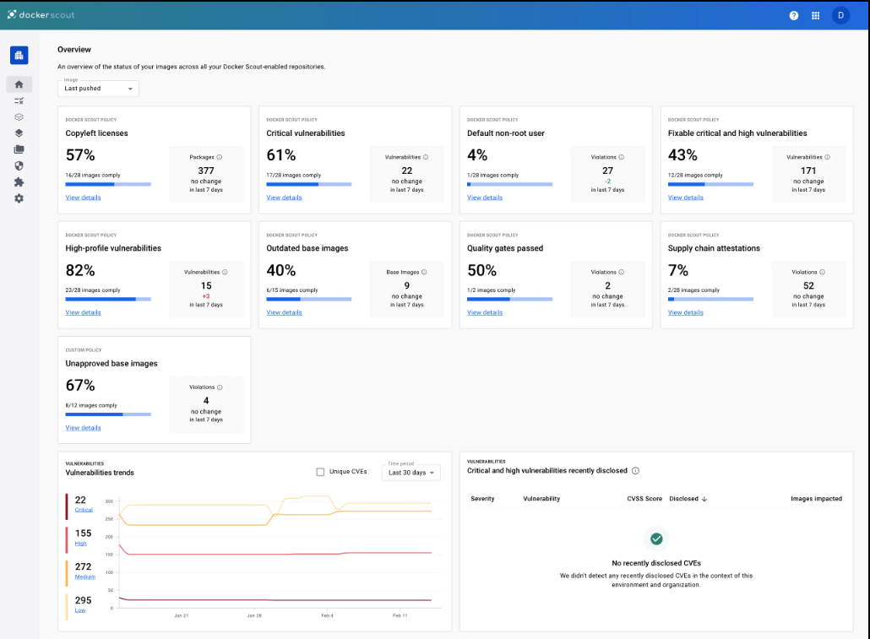
Docker Scout for Image Security

Slide 41
Trivy and Dockle Overview
Trivy scans images, filesystems, and repositories
Detects OS and language-specific vulnerabilities
Dockle performs container image best-practice checks
Identifies insecure configurations and metadata issues
Tools complement Docker Scout for deeper analysis
Widely adopted in DevSecOps pipelines

Slide 42
Container Hardening Techniques
Run containers as non-root users
Use minimal base images to reduce attack surface
Drop unnecessary Linux capabilities
Add HEALTHCHECK instructions
Avoid embedding secrets in images
Apply read-only file systems where possible

Slide 43
Fixing Vulnerabilities in Images
Upgrade base images to patched versions
Update application dependencies regularly
Remove unused packages and tools
Replace vulnerable libraries when no patch exists
Rebuild and rescan images after fixes
Document remediation decisions for audits

Slide 44
Security Gates in CI/CD Pipelines
Fail builds on critical or high-severity CVEs
Store SBOMs as pipeline artifacts
Enforce base image version policies
Automate vulnerability scanning on pull requests
Provide feedback to developers early
Ensure consistent security enforcement

Slide 45
Key Takeaways from Module 2
Image security is a supply chain responsibility
SBOMs provide transparency and compliance readiness
Vulnerability scanning must be automated
Multiple tools offer complementary insights
Hardening reduces runtime attack surface
Secure images are foundational for AI workloads

Slide 46
What Are DevContainers?
Development environment defined as code
Runs inside Docker containers
Uses devcontainer.json configuration
Integrated deeply with VS Code
Ensures reproducibility & isolation
Ideal for AI & security‑sensitive workloads

Slide 47
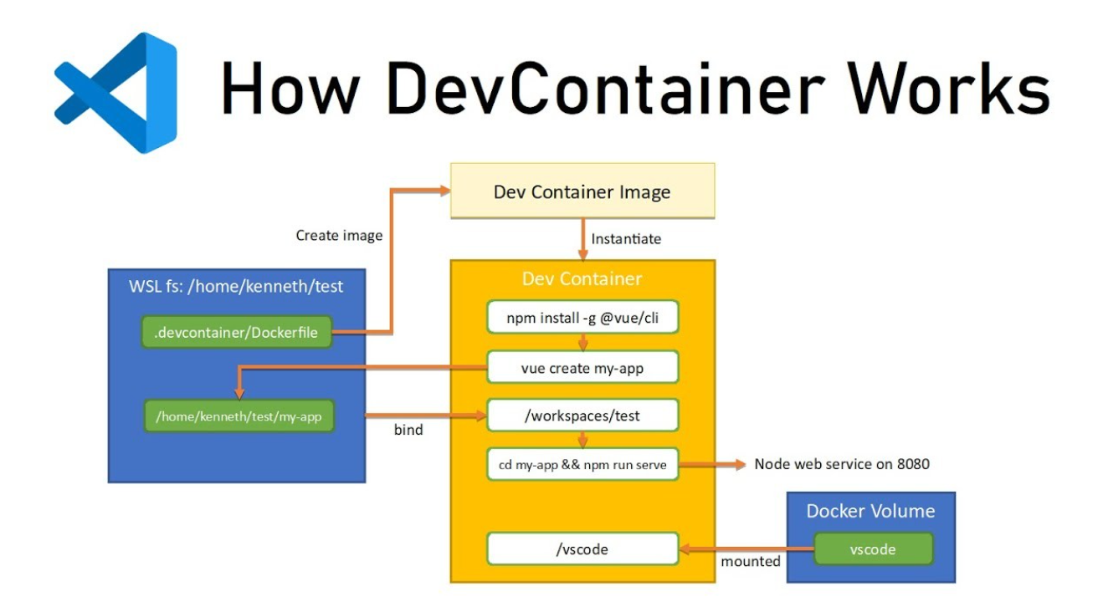
What Are DevContainers?

Slide 48
Problems DevContainers Solve
Inconsistent developer environments
Manual onboarding & setup delays
Tooling version conflicts
Security drift across machines
AI tools behaving inconsistently
Production mismatch issues

Slide 49
DevContainer Architecture
VS Code as client
Docker as execution engine
devcontainer.json as control plane
Optional Dockerfile or docker‑compose
Extensions installed inside container
Terminal runs inside container context

Slide 50
Key DevContainer Files
.devcontainer/devcontainer.json
Dockerfile for custom images
docker‑compose.yml for multi‑service setups
Feature definitions for tooling
VS Code customizations
Post‑creation automation scripts

Slide 51
devcontainer.json – Core Fields
name – logical environment identifier
image or build configuration
features – prebuilt tooling blocks
customizations for VS Code
postCreateCommand automation
remoteUser for security best practice

Slide 52
Using Images vs Dockerfile
Prebuilt images for faster startup
Dockerfile for full control
Better AI tooling integration with Dockerfile
Production parity advantages
Security customization
Enterprise standardization

Slide 53
DevContainer Features Explained
Reusable building blocks
Docker‑in‑Docker capability
Language runtimes (Node, Python, Go)
CLI tool installation
No manual dependency management
Consistent tooling across teams

Slide 54
VS Code Remote Containers Workflow
Install Docker & VS Code
Add Dev Containers extension
Clone repository
Reopen project in container
Container builds automatically
Development happens inside container

Slide 55
AI‑Augmented Development
AI tools run inside containers
Consistent AI behavior
Secure model experimentation
Local agent execution
Shift‑left security & compliance
Foundation for agentic systems

Slide 56
MCP CLI Tools Overview
docker ai – AI‑assisted container workflows
Shift‑left DevSecOps tooling
AI‑ready container governance
Enterprise compliance readiness

Slide 57
docker ai – Key Capabilities
Explain Dockerfiles using AI
Suggest optimizations
Debug container issues
Generate container templates
Improve developer productivity
Acts as container Copilot

Slide 58
DevContainer Best Practices
Use non‑root users
Minimize image size
Pin tool versions
Automate setup via postCreateCommand
Keep environments reproducible
Align with CI/CD pipelines

Slide 59
How This Enables Agentic Workflows
Agents run in isolated containers
Tool execution sandboxing
Secure AI experimentation
Composable AI pipelines
Easy transition to Dagger workflows
Foundation for autonomous systems

Slide 60
Module 3 Summary
DevContainers enable DevX excellence
AI tools become reproducible
MCP tools ensure security & compliance
VS Code integration simplifies adoption
Hands‑on skills are production‑ready
Sets stage for advanced agentic modules

Slide 61
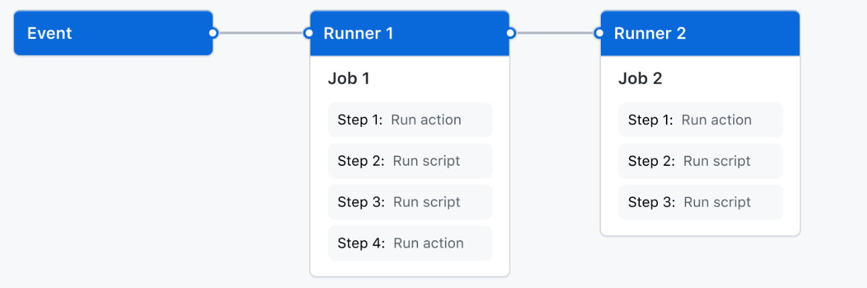
GitHub Actions: CI/CD & DevSecOps
Native CI/CD platform built into GitHub
Enables automation, security, and compliance
Pipelines as security enforcement points
Azure-centric, cloud-agnostic principles

Slide 62
Why GitHub Actions
CI/CD lives where the code lives
Event-driven, YAML-based pipelines
Strong ecosystem and security integrations
CI/CD as governance layer

Slide 63
GitHub Actions Architecture
Event-driven execution model
Workflows defined as code
Jobs run on isolated runners
Reproducible and auditable pipelines

Slide 64
Core Concepts
Workflow – pipeline definition
Event – trigger
Job – stage
Step – command or action
Runner – execution environment

Slide 65
Workflow Triggers
push – code changes
pull_request – security validation
workflow_dispatch – manual
schedule – periodic scans

Slide 66
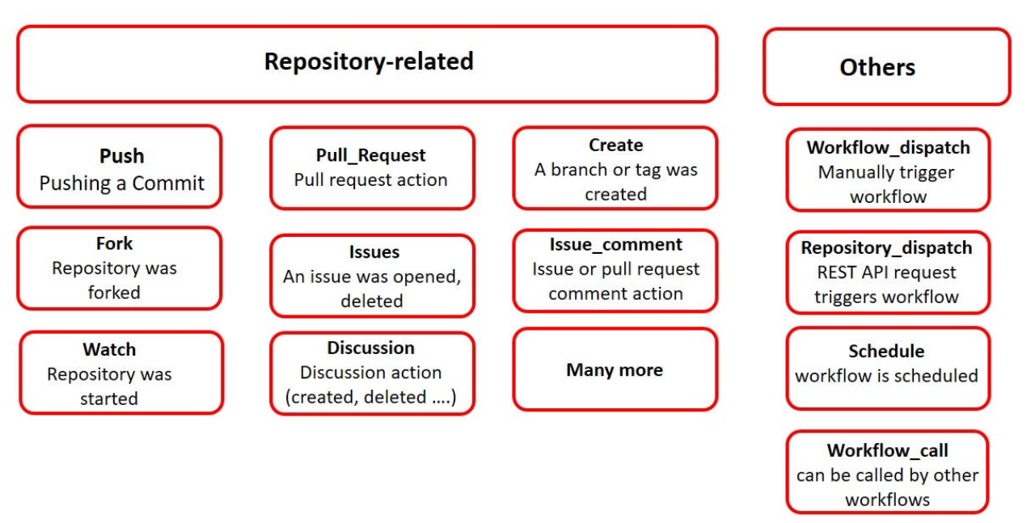
Workflow Triggers

Slide 67
Jobs & Parallelism
Parallel execution by default
needs enforces order
Fail fast on security issues

Slide 68
Runners
GitHub-hosted – ephemeral and secure
Self-hosted – private network access
Prefer ephemeral runners

Slide 69
Secrets Management
Encrypted secrets
Masked logs
Repo, environment, org scope
Separate per environment

Slide 70
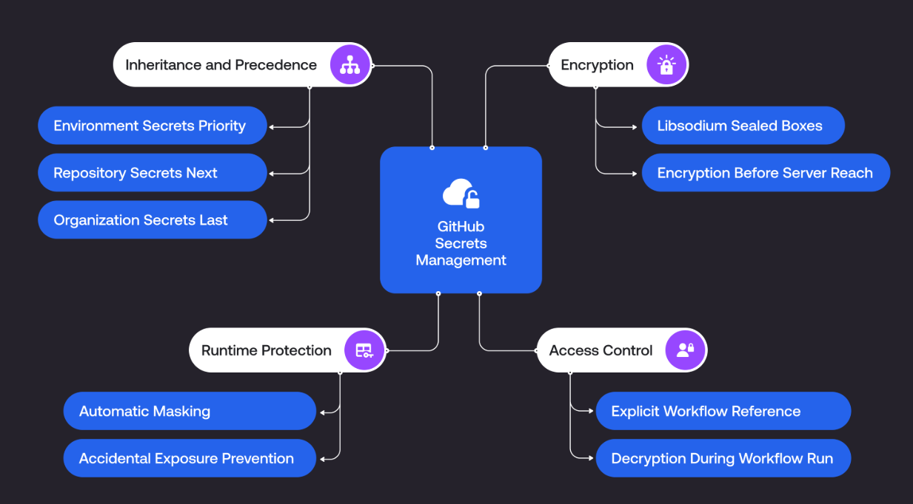
Secrets Management

Slide 71
Environments & Approvals
Dev / Test / Prod separation
Manual approvals
Audit trails

Slide 72
Reusable Workflows
Centralized pipeline logic
Standard security workflows
Platform-owned pipelines

Slide 73
Workflows
Creating an example workflow - GitHub Docs

